Slide 1

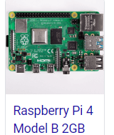

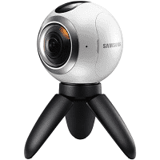

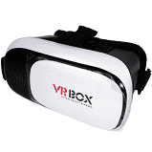


Creating and Sharing XR Experiences https://github.com/georgemck/xreality
“DIY Creating and Sharing XR” with George McKinney XReality Meetup Group Sat. June 27th from 10am-12pm PDT
https://www.meetup.com/XReality-AR-VR-MR-and-Beyond/events/270672383/

Slide 2

George McKinney
George McKinney grew up playing Atari and programming the Commodore 64 in Silicon Valley. He graduated from Stanford University and received his MBA from the University of Southern California. George began working in the software industry with WebConference.com, an early pioneer in online communications. For the past 15 years, he has worked as a software developer creating marketing experiences and enterprise software for companies including Disney, Kraft, Acura, Honda, and LG. He has built augmented/virtual/mixed/voice/IoT applications working with Amazon, Samsung, Microsoft, Qualcomm, BlackBerry and Oculus hardware.

Slide 3
Outline
Introduction and About You (3 minutes / )
Technology Review (15 minutes)
Content acquisition (15 minutes)
Capture - 360 camera
3D generation - Software
Website building
Build VR Website with Wordpress (20 minutes)
VR Demo with HTML5 Canvas using Three.js (20 minutes)
Q & A / Other Topics(60 minutes)
App and Game Development
Content Distribution

Slide 4
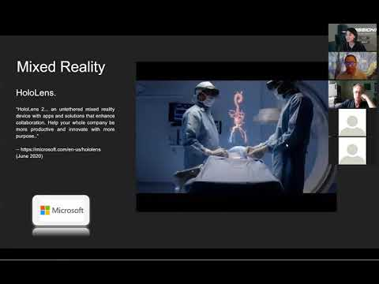
YouTube Recording
https://www.youtube.com/watch?v=5mZyYdH-uHs&feature=youtu.be

Slide 5
XR EXAMPLES
For the best experience view this on Google Drive at https://3dvu.co/xreality

Slide 6
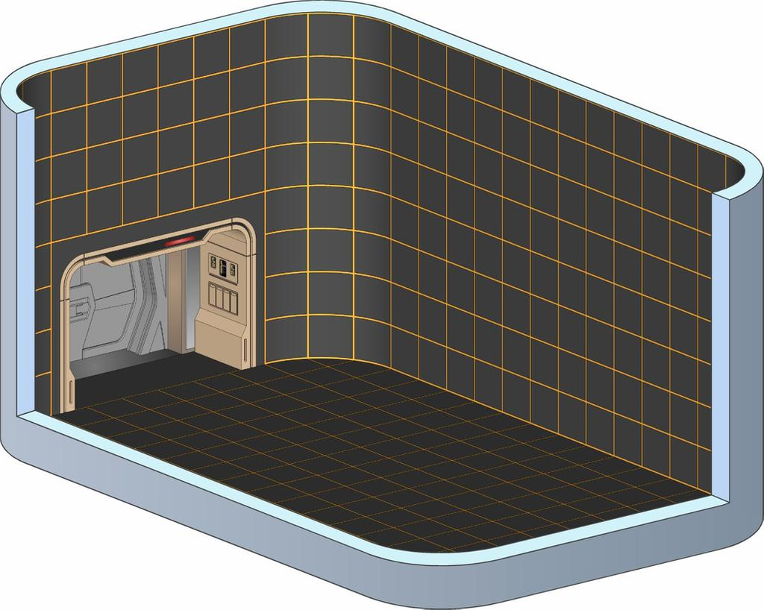

Star Trek Enterprise Holodeck
Rendering by Bobye2 What year was the first Holodeck in Star Trek?
https://www.deviantart.com/bobye2/art/NCC-1701-D-Holodeck-variant-628438072
Notes:
https://www.deviantart.com/bobye2/art/NCC-1701-D-Holodeck-variant-628438072 1974 cartoon, 1988 Next Generation. https://en.wikipedia.org/wiki/Holodeck

Slide 7
(X) Reality:
Augmented Reality (AR) : requires a camera and watched through a screen. You see the real world through a screen while computer generated content is placed in front of you.
Virtual Reality (VR): usually with a headset; can use a camera. Mostly computer generated content but real-world elements can be brought in.
Mixed Reality (MR): an enhancement of AR where real world elements are used to ground computer generated content.
Spatial Audio: Audio that allows you to orient yourself in the space you are in.
Extended Reality (XR): in general any of the experiences above. X, like in math, is a variable that can hold any value (A, V, M).

Slide 8
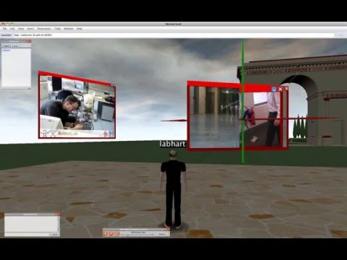
Virtual Reality
Wonderland Video Player Testing in Java
“Experimenting with some random movies and the Video Player in Open Wonderland -- most of the stuttering (avatar jumping around) is caused by the screen-capturing software (recording at 1680x1050), performance within Wonderland is actually very smooth. Only the video with loud music (MPEG-4, stereo AAC at 48 KHz) stutters a bit.” -- Nathan Labhart (November 2010) https://www.oracle.com/technetwork/systems/ts-6125-158848.pdf
Programmed in Java
Notes:
From https://www.aneddoticamagazine.com/open-wonderland/ https://youtu.be/KuMnaAizRHE https://youtu.be/ei39rcGsD0g http://images.businessweek.com/ss/08/05/0505_ceo_guide/index_01.htm

Slide 9

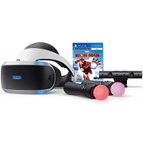
Virtual Reality
Good Dog, Bad Dog.
“A game that puts the player in the paws of a dog and allows them to be as good or as bad a dog as they want to be… Good Dog, Bad Dog is a game about having the same experience as your pet dog does, from running after tennis balls to soiling the best rug in the house.... Currently only on PlayStation®4 and PlayStation®VR” -- Brad Nelson (June 2020)
Programmed in C# with Unity 3D
Notes:
From https://store.playstation.com/en-us/product/UP0527-CUSA18994_00-GOODDOGBADDOG000 http://www.play-em.com/

Slide 10
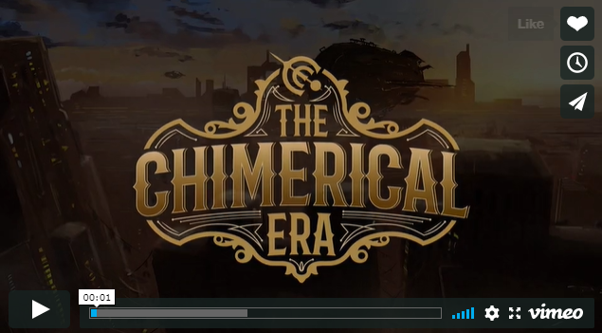

Cinematic Virtual Reality
An immersive Cinematic VR Storytelling Experience! Veronica Flint Creator. Writer. Creative Director.
This is Magic! Programmed in C# with Unity 3D
Notes:
From https://www.thechimericalera.com/

Slide 11
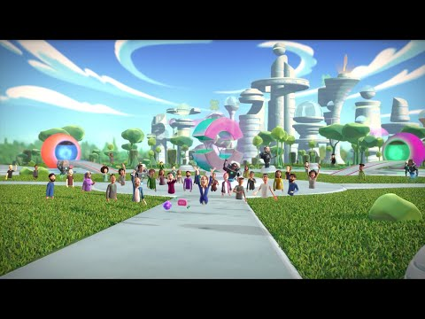

Social VR
Oculus Quest.
“Introducing ‘Facebook Horizon,’ a New Social VR World, Coming to Oculus Quest and the Rift Platform in 2020” ----- https://www.oculus.com/blog/introducing-facebook-horizon-a-new-social-vr-world-coming-to-oculus-quest-and-the-rift-platform-in-2020 (September 2019)
Facebook
Notes:
From https://www.oculus.com/blog/introducing-facebook-horizon-a-new-social-vr-world-coming-to-oculus-quest-and-the-rift-platform-in-2020/?locale=en_US https://www.oculus.com/blog/introducing-facebook-horizon-a-new-social-vr-world-coming-to-oculus-quest-and-the-rift-platform-in-2020 htt ps://www.oculus.com/blog/introducing-facebook-horizon-a-new-social-vr-world-coming-to-oculus-quest-and-the-rift-platform-in-2020

Slide 12
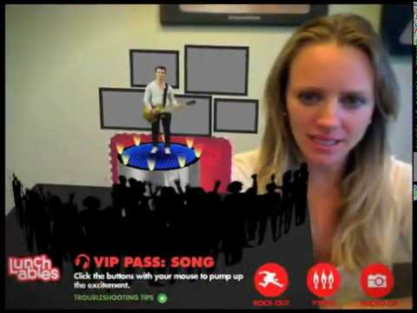
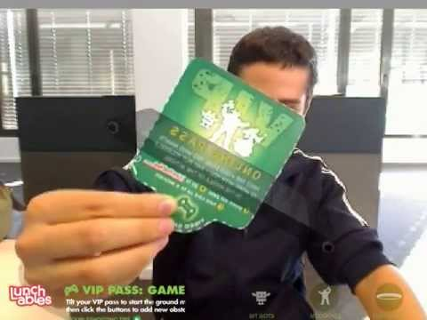

Augmented Reality
Kraft Lunchables
“Total Immersion was a leader in augmented reality. They created their D’Fusion platform in Lua programming language which was popular in game development at the time. After porting their engine to Adobe Flash Player and mobile devices, consumer brands began adopting AR broadly including this game I worked on for Kraft Lunchables.“ -- George McKinney (Aug. 2010)
Programmed in Actionscript. Total Immersion and Adobe Flash.
Notes:
Total Immersion (https://twitter.com/totalimmersion) project for Kraft Lunchables. https://youtu.be/3R41a7UeSjI https://www.youtube.com/watch?v=vJj3vjNQWvg Made using Adobe Flash Player for the Desktop browser

Slide 13
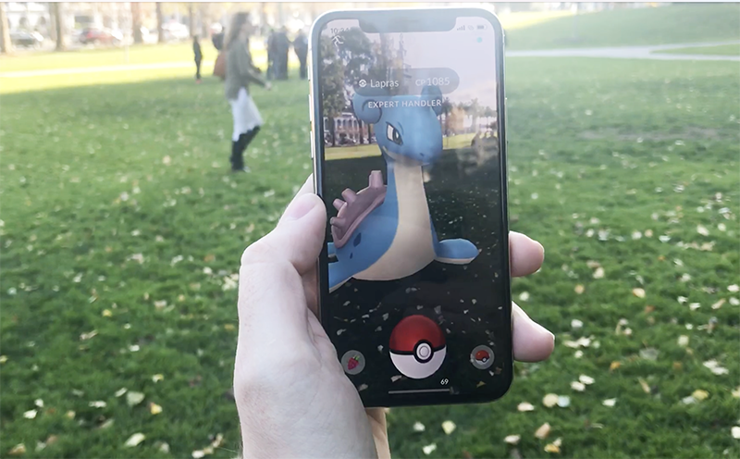
Augmented Reality
Pokémon GO “...promotes physical activity, which benefits cognition by helping children develop skills like spatial awareness and understanding cause-effect relationships, enabling kids to perform better at school -- getting exercise improves working memory, for example.”
-- JV Chamary (Feb. 2018)
Programmed in C# made with Unity 3D
Notes:
From: Pokémon GO gets a new and improved augmented reality mode (but only on iOS) Greg Kumparak@grg / 6:00 am PST•December 20, 2017 https://techcrunch.com/2017/12/20/pokemon-go-gets-a-new-and-improved-augmented-reality-mode-but-only-on-ios/ https://www.forbes.com/sites/jvchamary/2018/02/10/pokemon-go-science-health-benefits/#6596c3e13ab0

Slide 14
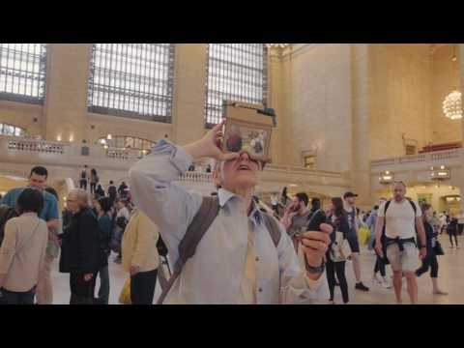
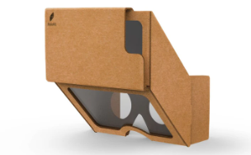
Mixed Reality
HoloKit.
“HoloKit: affordable open source mixed reality experience… HoloKit merges the real and the virtual in a smart way. While you see through the real world, virtual objects are blended into it. Powered by the accurate gyro and camera on smart phones, HoloKit solidly places virtual objects onto your table or floor, as if they were physically there without physical makers.” -- https://www.holokit.io (June 2017)
Made with Unity 3D
Notes:
From https://holokit.io/ https://play.google.com/store/apps/details?id=com.ambergarage.holokit https://apps.apple.com/us/app/holokit/id1237080840

Slide 15
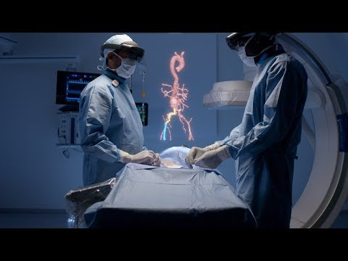

Mixed Reality
HoloLens.
“HoloLens 2... an untethered mixed reality device with apps and solutions that enhance collaboration. Help your whole company be more productive and innovate with more purpose..” -- https://microsoft.com/en-us/hololens (June 2020)
Notes:
From https://holokit.io/ https://www.youtube.com/watch?v=loGxO3L7rFE

Slide 16
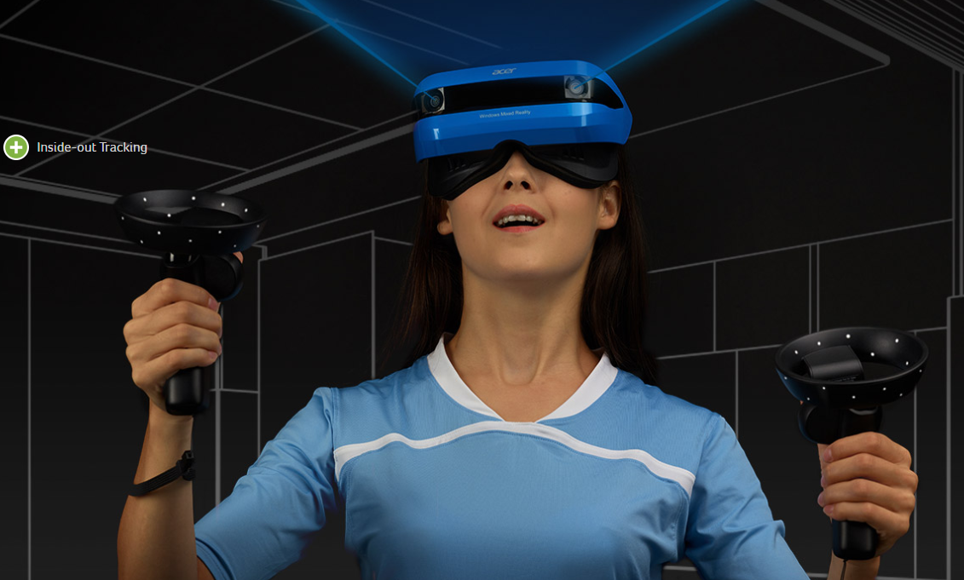

Mixed Reality
Windows Mixed Reality Headset.
“With personalized virtual surfaces chosen from travel, sports, culture, live concerts, time travel, games like Minecraft and 20,000+ universal Windows apps you can escape the everyday to enter your unique world..” ----- https://acer.com/ac/en/US/content/series-design/wmr (June 2020)
Notes:
From https://www.acer.com/ac/en/US/content/series/wmr

Slide 17


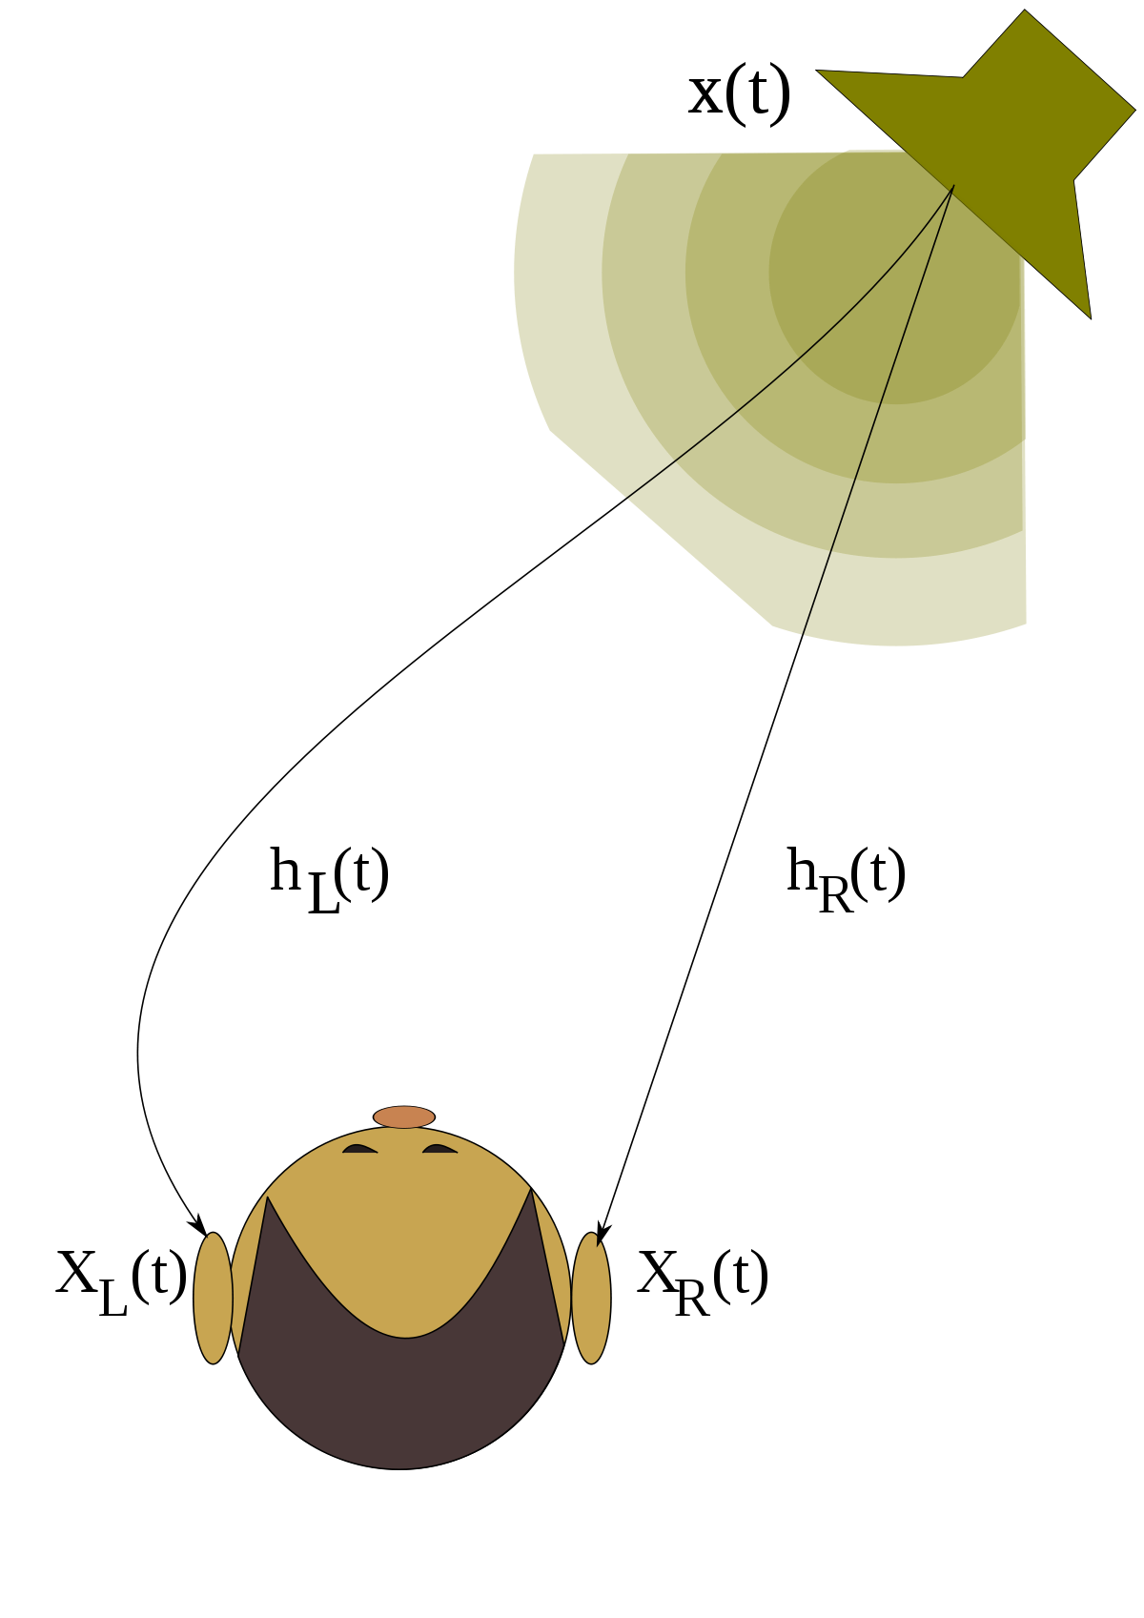
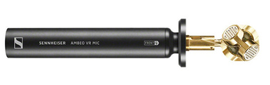


Spatial Audio
What is Audio 360, or spatial audio? “You can think of Audio 360 or spatial audio as an immersive sphere of audio that is delivered over headphones, just like humans hear sound in real life. In essence, it is possible to tell where a particular sound is coming from a point in space over a standard pair of headphones, without needing any external hardware or specialised piece of equipment. With 360 video and Virtual Reality, Audio 360 also changes instantly in real-time, as the user looks around either wearing a VR headset or rotates a smartphone where they are viewing the 360 content.” -- Facebook 360 https://facebook360.fb.com/spatial-workstation/
https://creator.oculus.com/learn/spatial-audio/
Notes:
https://en-us.sennheiser.com/ambeo https://www.razer.com/thx-spatial-audio https://creator.oculus.com/learn/spatial-audio/ https://facebook360.fb.com/spatial-workstation/ https://training.npr.org/2017/12/18/a-beginners-guide-to-spatial-audio-in-360-degree-video/#tips

Slide 18
OPPORTUNITIES
For the best experience view this on Google Drive at https://3dvu.co/xreality
Architecture
Industrial
Real Estate
Data Viz

Slide 19
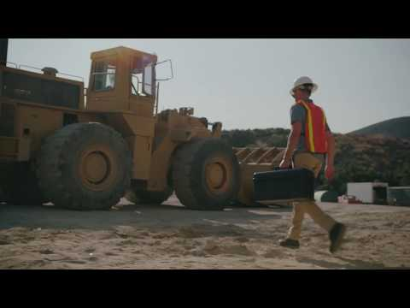
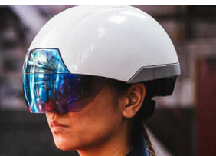



Enterprise AR
Daqri.
“WEARABLE SERVICE LINE BRING YOUR WORKFORCE, CUSTOMERS AND MACHINES TOGETHER WITH WEARABLE CAPABILITIES..” -- https://daqri.com (June 2020)
Notes:
From https://daqri.com/ https://www.autodesk.com/redshift/augmented-reality-in-construction/ https://epson.com/moverio-augmented-reality#

Slide 20
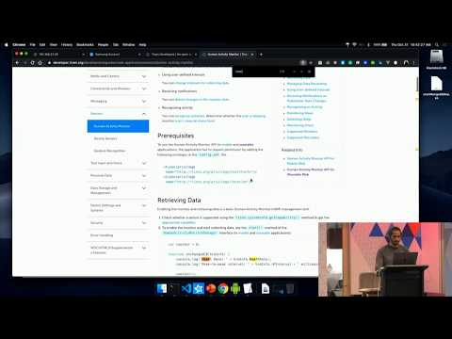
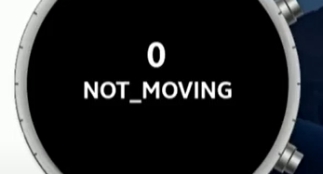
Construction
Wearables & WebXR.
At the Create 2019 Web Workshop in San Francisco, software developer Josue Bustos shares how to connect Samsung's Galaxy watch to WebXR experiences in his presentation. -- Josue Bustos (June 2020) Full Stack Serverless, Technical Consultant https://www.linkedin.com/in/josuebustos/
Notes:
From http://nuronet.io/ https://www.youtube.com/watch?v=5fEjIux1_wg https://www.linkedin.com/in/josuebustos/

Slide 21


Engineering
Wearables in the workplace.
“Augmented reality in construction and architecture projects involves placing a 3D model of a proposed design onto an existing space using mobile devices and 3D models.” https://www.autodesk.com/redshift/what-is-augmented-reality/
Notes:
From https://www.autodesk.com/redshift/what-is-augmented-reality/

Slide 22
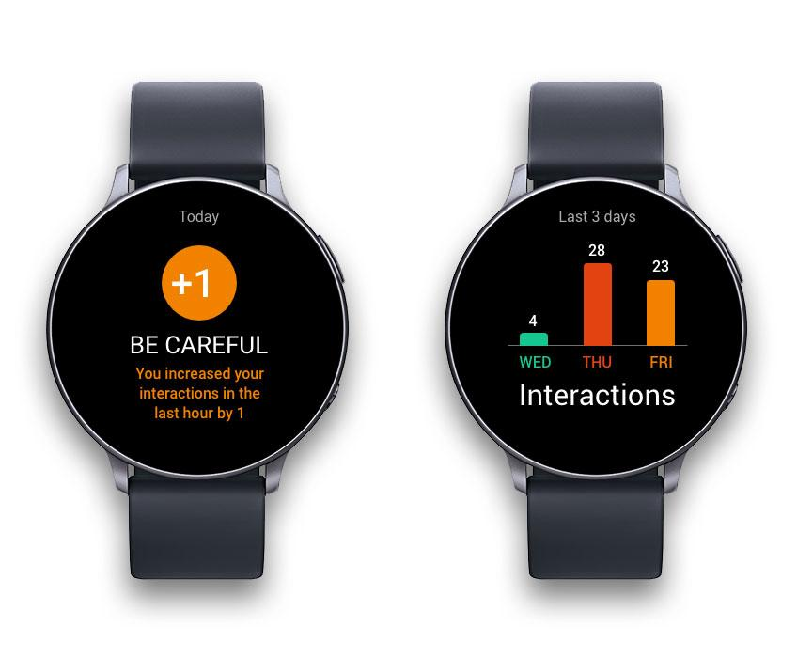

Engineering
Wearables in the workplace.
“Ford Tests Buzzing Wristbands to Keep Workers at Safe Distances” By Keith Naughton April 15, 2020
https://www.bloomberg.com/news/articles/2020-04-15/ford-tests-buzzing-distancing-wristbands-to-keep-workers-apart
Notes:
From https://www.bloomberg.com/news/articles/2020-04-15/ford-tests-buzzing-distancing-wristbands-to-keep-workers-apart https://www.samsung.com/us/mobile/wearables/

Slide 23
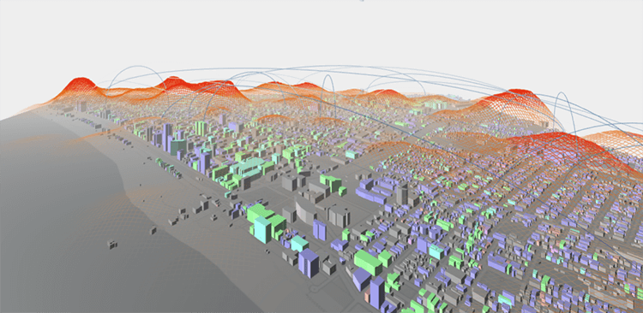

Big Data
Telecom. Smart Cities. Marketing.
“We're fundamentally advancing how people understand and interact with their data.” -- BadVR.com (June 2020)
http://datavizcatalogue.com/blog/whos-offering-data-visualization-vr/
Notes:
From http://datavizcatalogue.com/blog/whos-offering-data-visualization-vr/ badvr.com

Slide 24
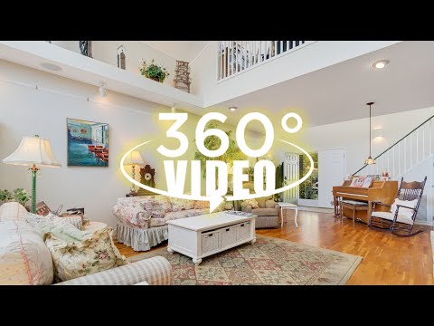
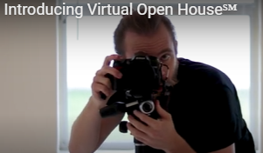
360 Video
Virtual Open House.
“Aleksey Volchek is a Zillow Certified Photographer serving Palm Coast, FL and beyond..” -- http://VirtualOpen.House (June 2020) https://www.youtube.com/channel/UCmY_NJGs7SWmgAep218s3Sg
Notes:
From https://youtu.be/soS-Afm50Os http://www.VirtualOpen.House

Slide 25


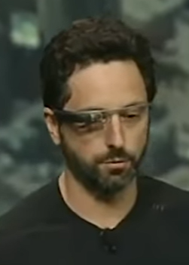

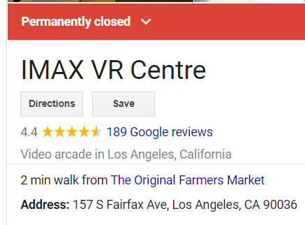

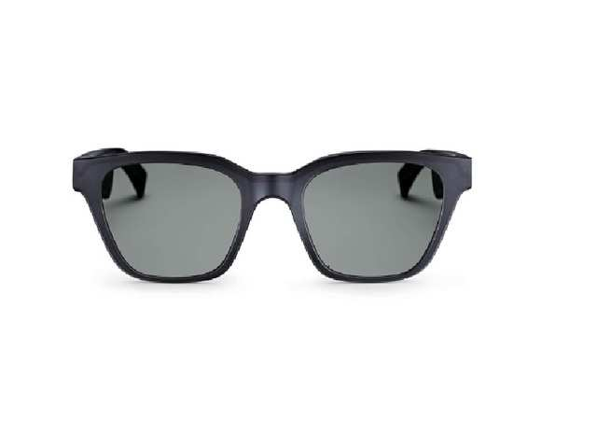
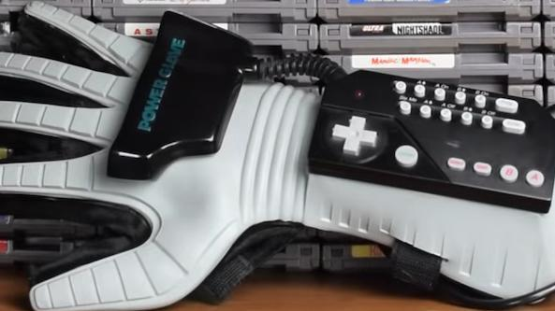
XR GRAVEYARD: In Memory of failed approaches...
Bose AR
Notes:
Graveyard is full of doom and gloom…

Slide 26
TECHNOLOGY
For the best experience view this on Google Drive at https://3dvu.co/xreality

Slide 27
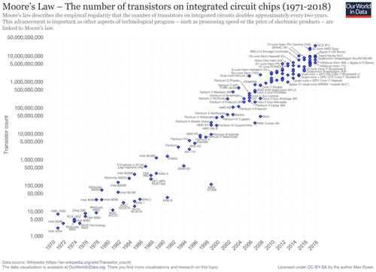
What is Moore’s Law
Moore's law is the observation that the number of transistors in a dense integrated circuit (IC) doubles about every two years. Moore's law is an observation and projection of a historical trend. Rather than a law of physics, it is an empirical relationship linked to gains from experience in production. -- Wikipedia https://en.wikipedia.org/wiki/Moore%27s_law Gordon Moore, Co-Founder of Intel
Notes:
https://en.wikipedia.org/wiki/Moore%27s_law

Slide 28
XR has benefited from Moore’s Law
From server, to desktop, mobile, cloud and IoT...
Denser Transistors (ARM, x86)
Miniaturization (smart phones)
Distribution (cloud computing)
Faster networks (Fiber Optics, 5G, Cable)
Notes:
https://en.wikipedia.org/wiki/Moore%27s_law

Slide 29
Technology Licensing
Standards-based (OpenCL, OpenGL ES aka WebGL)
Khronos Group sets 3D standards
Everyone refers to the standard
Open Source (Three.js, A-Frame, Babylon.js)
Understand what you are using
Free to use, Free to Innovate, Free to Contribute
Closed Source (Unity 3D, Unreal, Autodesk, Adobe)
Restricted use
Costs money

Slide 30

STANDARDS

Slide 31

Closed Source
Unity.com Game engine
Mobile Apps (iPhone and Android)
Game Consoles (Sony Play Station, Xbox, Sega)
Computers (Mac, VR only works on Windows)
Automotive, Transportation
Architecture, Engineering
Film, Television

Slide 32



Closed Source
UnrealEngine.com Game engine

Slide 33
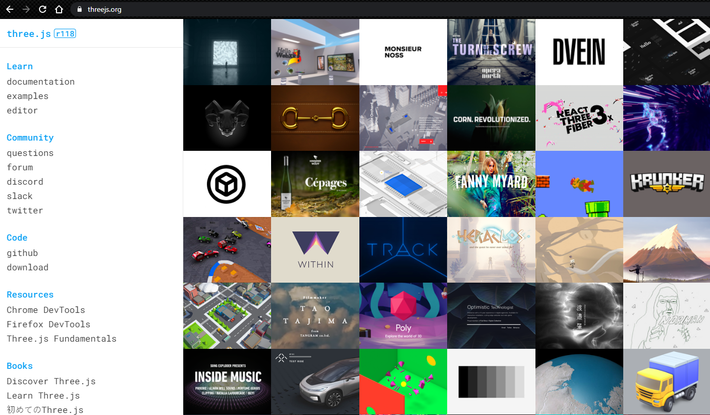

Open Source
Check out Three.js
https://threejs.org/
Notes:
https://threejs.org/examples/#webgl_materials https://threejs.org/

Slide 34

David Lyon’s 121 slides
https://davidlyons.dev/threejs-intro/#slide-0
Notes:
https://davidlyons.dev/threejs-intro/#slide-0

Slide 35
DIGITAL ASSETS
For the best experience view this on Google Drive at https://3dvu.co/xreality

Slide 36
Capture, Draw, Copy or Code?
The first hurdle to overcome in working in XR is acquire content to explore!

Slide 37
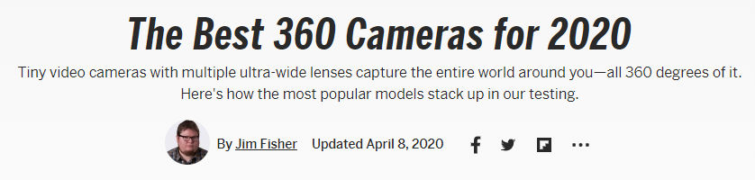
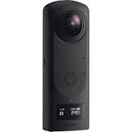
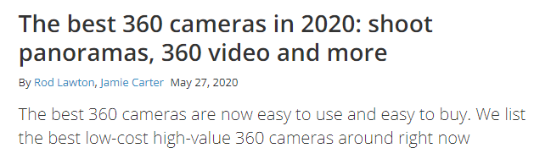
360 Cameras for Capture
So many choices Consider stitching software, Live-streaming, try out the mobile app
https://www.pcmag.com/picks/the-best-360-cameras
https://www.digitalcameraworld.com/buying-guides/best-360-cameras
Notes:
https://www.pcmag.com/picks/the-best-360-cameras https://www.digitalcameraworld.com/buying-guides/best-360-cameras

Slide 38


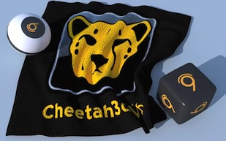






3D Drawing Software
Create your own content Using one of these software You will also need basic image Program like Gimp/Photoshop/Paint
www.autodesk.com
Autodesk Maya
Notes:
www.autodesk.com blender.org https://www.sketchup.com/ https://www.cheetah3d.com/ https://www.adobe.com/products/dimension.html

Slide 39
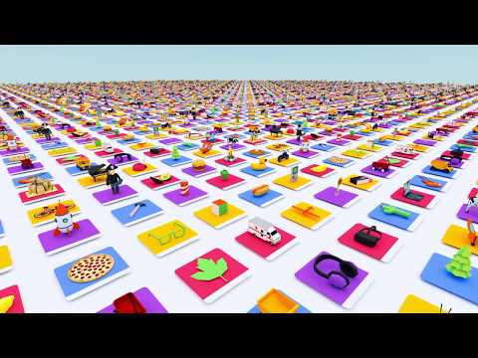



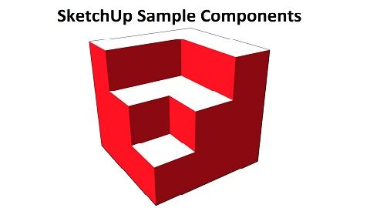


3D Asset Stores for Content
Notes:
https://poly.google.com/ https://3dwarehouse.sketchup.com/?hl=en https://www.deviantart.com/tag/3d https://www.behance.net/search/projects/?search=3D

Slide 40
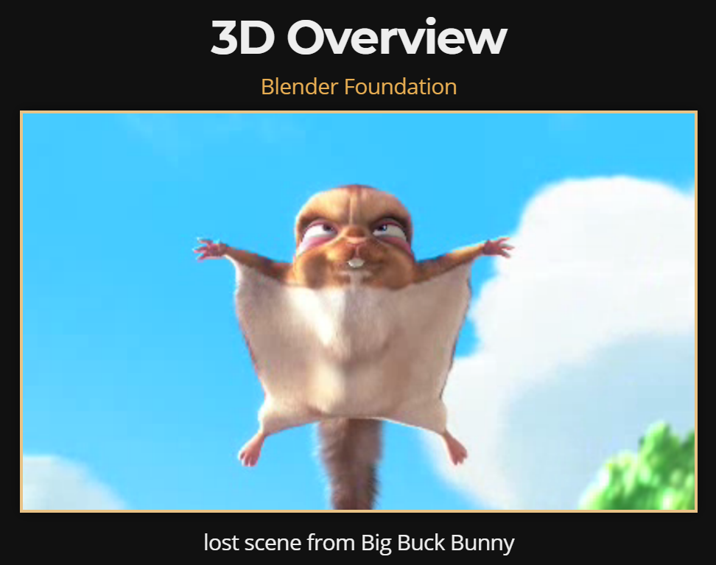

Slide 41
3D Overview
Scene
Camera
Renderers

Slide 42
Lights
Ambient
Directional
Point
Spot

Slide 43
Textures and Materials
UV Maps
Solid
2D
Video

Slide 44
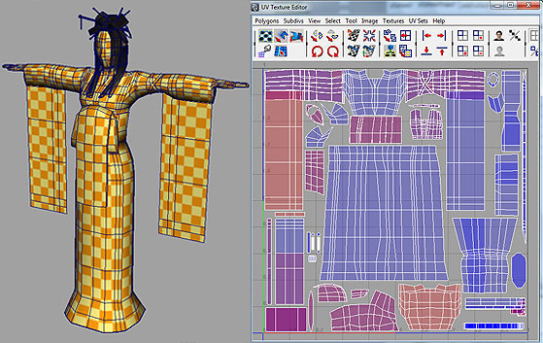
UV Texture Map
Geisha 3D Model by Keiko Kamata

Slide 45
Geometries
Cubes
Cylinders
Lines
Particles
Planes
Polyhedrons
Spheres
Text in 3D

Slide 46
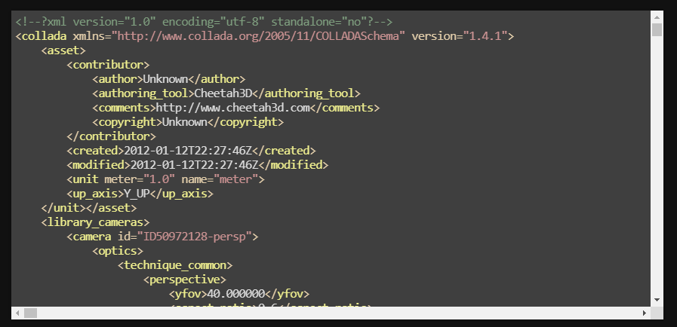
Collada DAE
Standards-based asset sharing

Slide 47
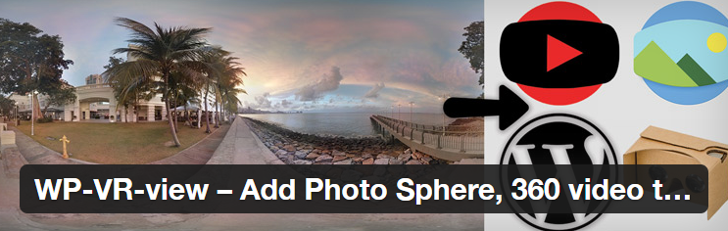
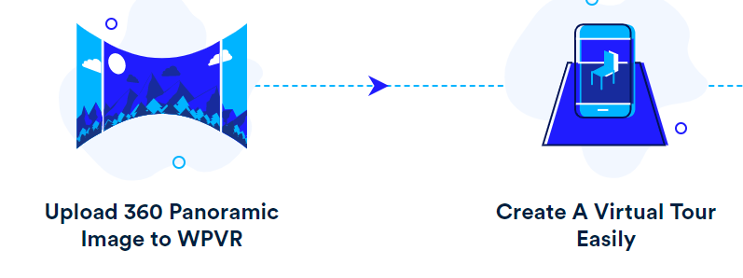
Check out WordPress VR Plugins
WP-VR-view How to add Photo Sphere and 360 Video
https://www.youtube.com/watch?v=DWkLce9M-h0 https://wordpress.org/plugins/wp-vr-view/ (this app needs an update but still works, June 2020)
WP VR https://wordpress.org/plugins/wpvr/ Freemium
Notes:
https://wordpress.org/plugins/wp-vr-view/ https://wordpress.org/plugins/wpvr/

Slide 48
MY WORK
Kraft Lunchables Augmented Reality https://www.georgemckinney.com/game-song-and-movie/
Mobile Augmented Reality using Javascript (JS-Aruco) https://www.georgemckinney.com/mobile-augmented-reality-app
Mobile AR Presentation at HTML5 Developer Conference 2013 https://www.georgemckinney.com/armobile/
360 Video: Triforium Fridays Nov. 2018 https://www.youtube.com/watch?v=2tfdSGFCWVE
360 Web VR Scene https://midivrcard.com/wintergreeting.html

Slide 49
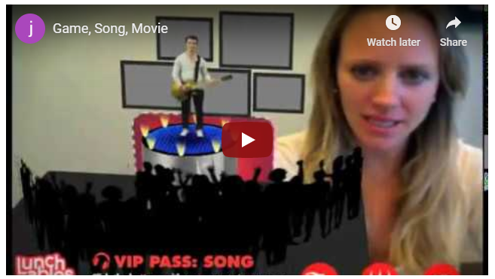
Kraft Lunchables
Augmented Reality using Adobe Flash and Total Immersion D’Fusion
https://www.georgemckinney.com/game-song-and-movie/
Notes:
https://www.georgemckinney.com/game-song-and-movie/

Slide 50
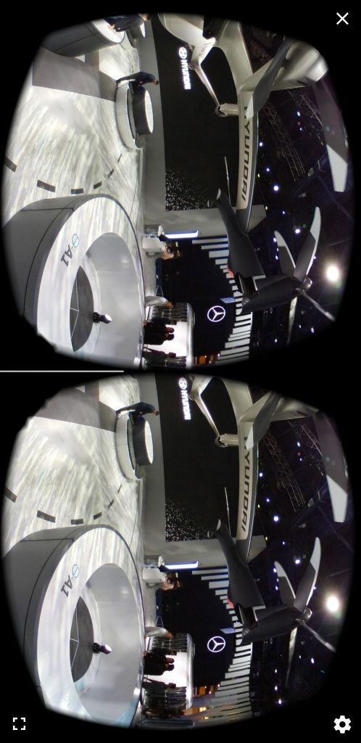
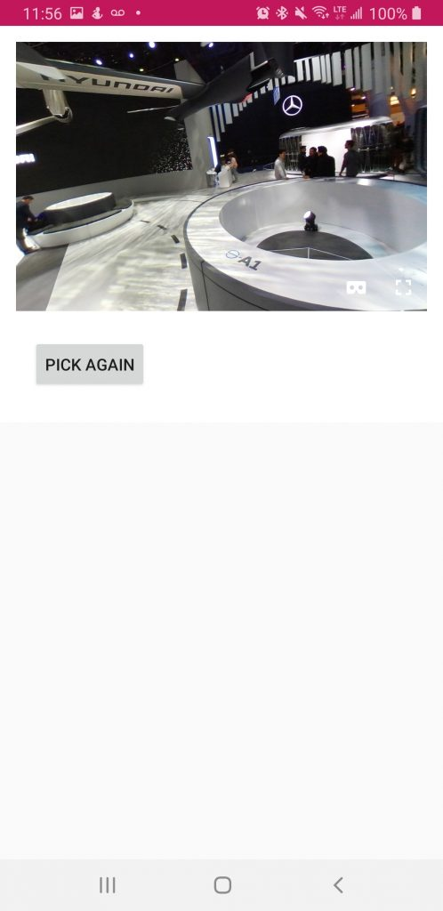
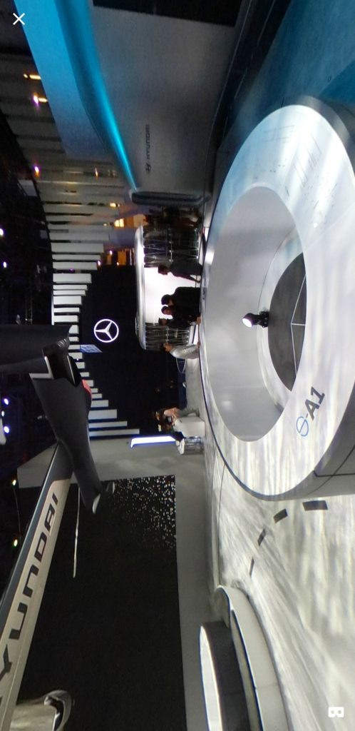
Android App 360 Image Viewer (in Beta)
https://developers.google.com/cardboard
Notes:
https://developers.google.com/cardboard https://www.georgemckinney.com/android-app-360-image-viewer/

Slide 51
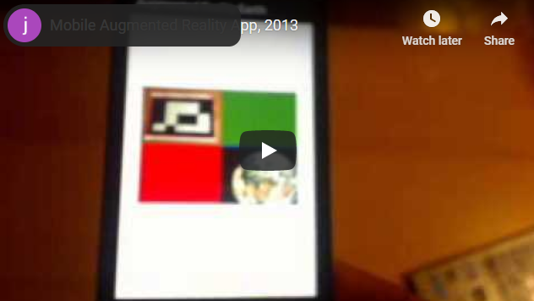
Mobile Augmented Reality
Using Javascript, BlackBerry WebWorks, (JS-Aruco)
https://www.georgemckinney.com/mobile-augmented-reality-app
Notes:
https://www.georgemckinney.com/mobile-augmented-reality-app Z10

Slide 52
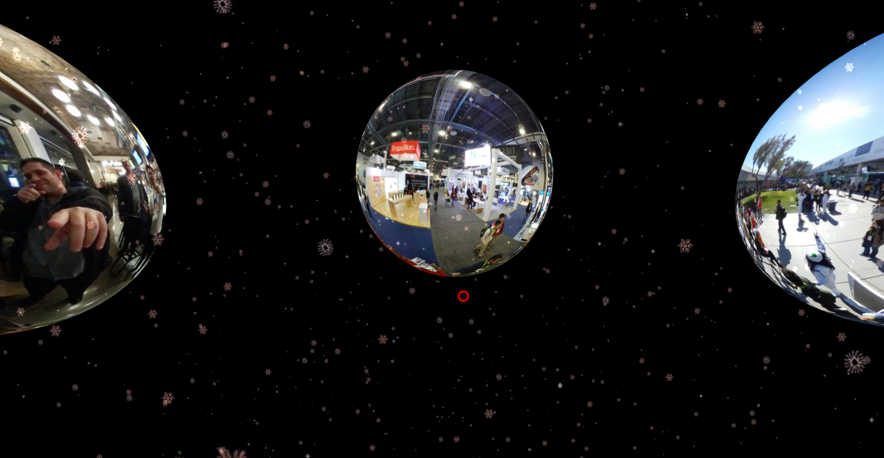
360 Web VR Scene
360 Photo Sphere Gallery with Gaze Navigation
https://midivrcard.com/wintergreeting.html
Notes:
https://midivrcard.com/wintergreeting.html

Slide 53

Mobile AR Preso, SF HTML5 DevConf 2013
Augmented Reality using Adobe Flash and Total Immersion D’Fusion
https://www.georgemckinney.com/armobile/
Notes:
https://www.georgemckinney.com/armobile/

Slide 54
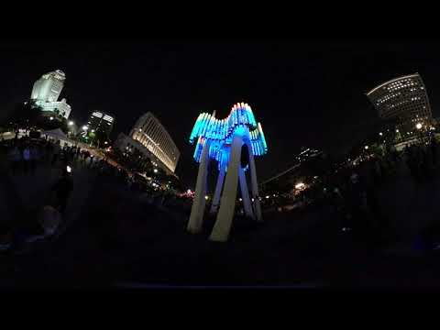
360 Video: LA Triforium Nov. 2018
Musical performance captured with Samsung Gear 360, shared on YouTube.
https://www.youtube.com/watch?v=2tfdSGFCWVE
Notes:
https://www.youtube.com/watch?v=2tfdSGFCWVE

Slide 55
CLOSING

Slide 56
The Future is Voice
Powerful Human to Computer Interaction Technologies and will get better with time
Machine Learning Databases
OK, Google
Siri
Cortana
Alexa

Slide 57
People I Follow
Tony Parisi https://medium.com/@tonyparisi
Mr. Doob https://github.com/mrdoob
Dominique Wu https://www.linkedin.com/in/dominiquewu/
Veronica Flint https://www.linkedin.com/in/corveniaflint/
Brad Nelson https://www.linkedin.com/in/playem/
Rob Bateman https://github.com/rob-bateman
Yosun Chang https://twitter.com/yosun

Slide 58
My Blogs
https://3dvu.co/blog
https://www.georgemckinney.com/

Slide 59
Reach Out on Social Media
Github https://github.com/georgemck Twitter https://twitter.com/georgemck LinkedIn https://www.linkedin.com/in/georgemckinney/ YouTube https://www.youtube.com/jamatatechnologies
Meetup https://www.meetup.com/laphonegap/

Slide 60



Industry Events
https://www.siggraph.org/ https://gdconf.com/ https://www.awexr.com/

Slide 61

360 VR Workflow with Adobe Premiere
A beginner’s guide to spatial audio in 360-degree video NICK MICHAEL • DECEMBER 18, 2017. https://training.npr.org/2017/12/18/a-beginners-guide-to-spatial-audio-in-360-degree-video/#tips
Ingest. Move files from cards to hard drives. Organize your media so you can easily locate multiple video angles and audio files from the same scene. Renaming files with custom pre-fixes is one way to keep file groups together.
Stitch. Stitch your angles. Depending on the timeline and complexity of your shoot, you might only do a rough stitch for review here. Then, after you’ve picture-locked, you can carefully re-stitch only your final shots.
Set project and sequence settings. Adobe has more specifics here.
Sync audio and video. Lay out a sequence in which to sync all your audio and video clips. Draw your edit selections from here.
Edit. Shots need to sit on screen long enough for people to look around. A good minimum seems to be 15-20 seconds.
Graphics and titling. Design your graphics presentation. We’ve placed titles in every quadrant, but your project may require something different. Prevent graphics bubbling with a plugin like SkyBox (included in Adobe Premiere 2018 CC).
Final stitch + audio mix + color correction. Finesse it all!
Export. Consult Adobe for the latest specifics.
Notes:
From NPR, A beginner’s guide to spatial audio in 360-degree video NICK MICHAEL • DECEMBER 18, 2017. https://training.npr.org/2017/12/18/a-beginners-guide-to-spatial-audio-in-360-degree-video/#tips

Slide 62
Interesting Experiences
Let Yayoi Kusama Take You to Infinity | The Daily 360 | The New York Times
https://www.youtube.com/watch?v=d26td0RDTlY
RICOH THETA S Live Streaming over USB - Alpha driver
https://www.youtube.com/watch?v=A8Al7U2ZeF0
Drone Racing League | Episode 2: Semi-Finals (Level 1: Miami Lights) | DRL
https://www.youtube.com/watch?v=0gYkZGOTdM0

Slide 63
More Cool
Rockchip Smart Glass https://www.youtube.com/watch?v=sYul3ROK-fk&t=66s
Coachella VR 360 https://www.youtube.com/watch?v=1mZQEfECluE&t=18s
Augmented Reality: Epson Moverio HackAThon - Intro
https://www.youtube.com/watch?v=UMdM0ciVWco
Hands on with the Epson Moverio BT-200 augmented reality smart glasses at CES 2014
https://www.youtube.com/watch?v=U59gMEXW0Yc

Slide 64
Resources
Virtual Reality and 360-degree Live Streaming with Wowza
https://www.youtube.com/watch?v=uhKso8ySa_E

Slide 65
Random Notes
Challenges of Mobile AR Sensors (more sensors, higher cost) SDKs Manufacturers Hardware Behavior Content PWA - A solution? General case - HCI Voice input IoT

Slide 66
Input Devices
Foot pedals https://www.amazon.com/s?k=transcription+foot+pedal&crid=3KHFGXE9X0HNF&sprefix=shower+%2Caps%2C260&ref=nb_sb_ss_organic-diversity_1_7

